Slide 1
CENG 538 Advanced Graphics and UIs
Curves and Surfaces

Slide 2
Various Object Representations
Types of objects: geometrical shapes, trees, terrains, clouds, rocks, glass, hair, furniture, human body, etc.
Not possible to have a single representation for all
Polygon surfaces
Spline surfaces
Procedural methods
Physical models
Solid object models
Fractals
……

Slide 3
Spline Representations
Spline curve: Curve consisting of continuous curve segments approximated or interpolated on polygon control points.
Spline surface: a set of two spline curves matched on a smooth surface.
Interpolated: curve passes through control points
Approximated: guided by control points but not necessarily passes through them.
Interpolated
Approximated

Slide 4
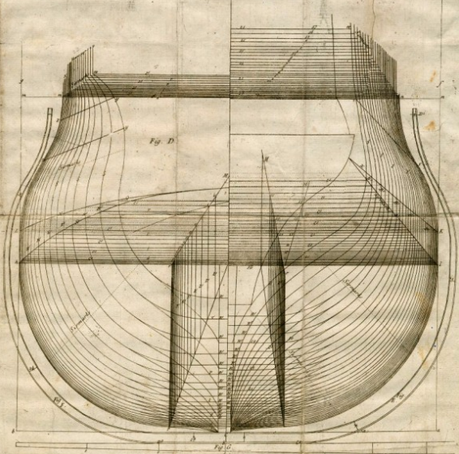
Spline Applications
Computation: You evaluate an expensive energy function at some few points; fit a spline to it to get its (interpolated or approximated) value at all other points instantly
Modeling: Ship/Boeing design, racket design, hair design, ..
Animation/robotics: Smooth out the path to trace

Slide 5
Parametric Continuity
Parametric equations:
x = x(u), y = y(u), z = z(u)
Parametric continuity: Continuity properties of curve segments.
Zero order: Curves intersects at one end-point: C⁰
First order: C⁰ and curves has same tangent at intersection: C¹
Second order: C⁰ , C¹ and curves has same second order derivative: C²
Change in rate of change
E.g., position’’ w.r.t. time is acceleration

Slide 6
Geometric Continuity
Similar to parametric continuity but only the direction of derivatives are significant. For example derivative (1,2) and (3,6) are considered equal.
G⁰, G¹, G² : zero order, first order, and second order geometric continuity.

Slide 7
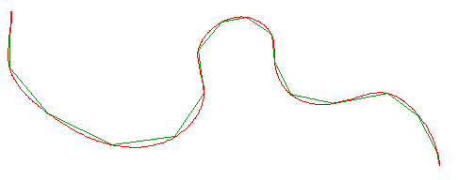
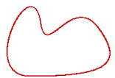
Curves
Polylines: piecewise linear approximation to curves
Not smooth
The green one is a polyline
The red one is a curve
Closed curve:

Slide 8
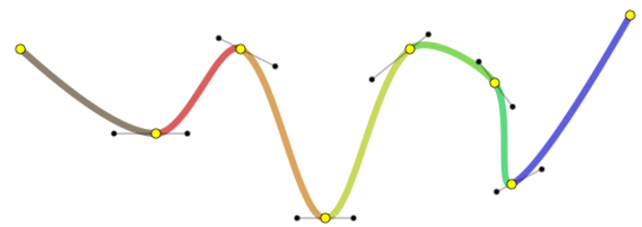
Curves
Spline is a smooth aggregation of multiple different curves
Spline can be defined piecewise by multiple polynomials
Curve is defined by a single polynomial
Curve is a special spline

Slide 9
Curves
Representations
Explicit: y = f(x)
Implicit: f(x, y) = 0
Parametric: x = x(t), y = y(t)

Slide 10
Curves
Representations
Explicit: y = f(x)
Essentially a function plot over some interval x \in [a, b]
Simple to compute, simple to check whether point lies on a curve
Cannot represent closed curves
Implicit: f(x, y) = 0
Solution of an equation system (ax + by + c = 0 for line in 2D)
Simple to check whether point lies on a curve
Can represent closed curves
Parametric: x = x(t), y = y(t)
Describe position on the curve by a parameter (c(t) = (1-t)a + tb for line in 2D)
Hard to check whether point lies on a curve
Can represent closed curves
Simple to render; just change t and get new x, y to render

Slide 11
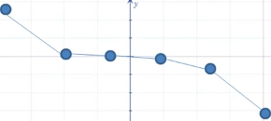
Curves
Polyline

Slide 12
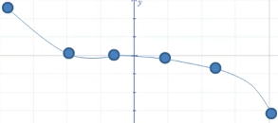
Curves
Piecewise quadratic f(x)

Slide 13
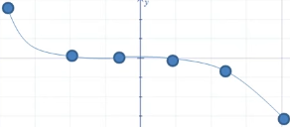
Curves
Piecewise cubic f(x)

Slide 14


Curves
Piecewise Cubic Spline
Even better ☺
What’s special about splines?
Function approximations that are continuous at merging points
Also have continuous first and second derivatives where they join

Slide 15
Curves
Piecewise Cubic Spline
Even better ☺
What’s special about splines?
Natural Cubic Spline is a Cubic Spline that has second derivative equal to 0 at the endpoints

Slide 16
Cubic Splines
Splines are parametric curves: P(u)
Cubic Splines (cubic polynomial of the parameter u)
P(u) = B₁ + B₂u + B₃u² + B₄u³
x(u) = B_{1x} + B_{2x}u + B_{3x}u² + B_{4x}u³
y(u) = B_{1y} + B_{2y}u + B_{3y}u² + B_{4y}u³
z(u) = B_{1z} + B_{2z}u + B_{3z}u² + B_{4z}u³
P’(u) = B₂ + 2B₃u + 3B₄u²
We will learn particular cubic splines from this family
Normalized Cubic Spline
Natural Cubic Spline
Clamped Cubic Spline
Cyclic/Anticyclic Cubic Spline
Cubic Hermite Spline //slightly different construction than four above

Slide 17
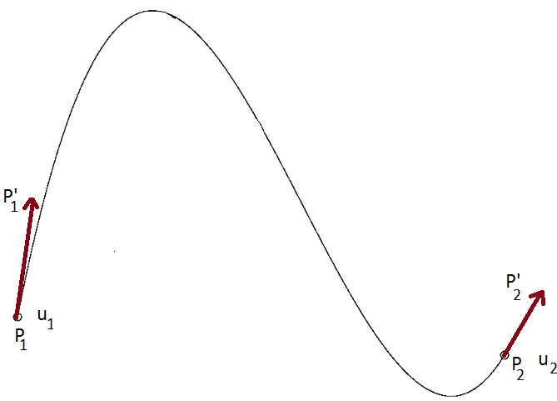
Spline Interpolation
Calculation of a cubic spline
Given positions P₁, P₂, and derivatives/tangents P’₁, P’₂

Slide 18
Spline Interpolation
Calculation of a cubic spline
Given P₁, P₂, and P’₁, P’₂
Let u₁ = 0
P(0) = P₁ P’(0) = P’₁
P(u₂) = P₂ P’(u₂) = P’₂
Use P(u) = B₁ + B₂u + B₃u² + B₄u³ for substitutions
P(0) = B₁ = P₁
P(u₂) = B₁ + B₂u₂ + B₃u₂² + B₄u₂³ = P₂
Use P’(u) = B₂ + 2B₃u + 3B₄u² for substitutions
P’(0) = B₂ = P’₁
P’(u₂) = B₂ + 2B₃u₂ + 3B₄u₂² = P’₂

Slide 19
Spline Interpolation
Calculation of a cubic spline
Given P₁, P₂, and P’₁, P’₂
Let u₁ = 0
P(0) = P₁ P’(0) = P’₁
P(u₂) = P₂ P’(u₂) = P’₂
Use P(u) = B₁ + B₂u + B₃u² + B₄u³ for substitutions
P(0) = B₁ = P₁
P(u₂) = B₁ + B₂u₂ + B₃u₂² + B₄u₂³ = P₂
Use P’(u) = B₂ + 2B₃u + 3B₄u² for substitutions
P’(0) = B₂ = P’₁
P’(u₂) = B₂ + 2B₃u₂ + 3B₄u₂² = P’₂

Slide 20
Spline Interpolation
Calculation of a cubic spline
Given P₁, P₂, and P’₁, P’₂
Let u₁ = 0
P(0) = P₁ P’(0) = P’₁
P(u₂) = P₂ P’(u₂) = P’₂
Use P(u) = B₁ + B₂u + B₃u² + B₄u³ for substitutions
P(0) = B₁ = P₁
B₃ = 3(P₂ - P₁)/u₂² - 2P’₁/u₂ - P’₂/u₂
Use P’(u) = B₂ + 2B₃u + 3B₄u² for substitutions
P’(0) = B₂ = P’₁
B₄ = 2(P₁ - P₂)/u₂³ + P’₁/u₂² + P’₂/u₂²

Slide 21
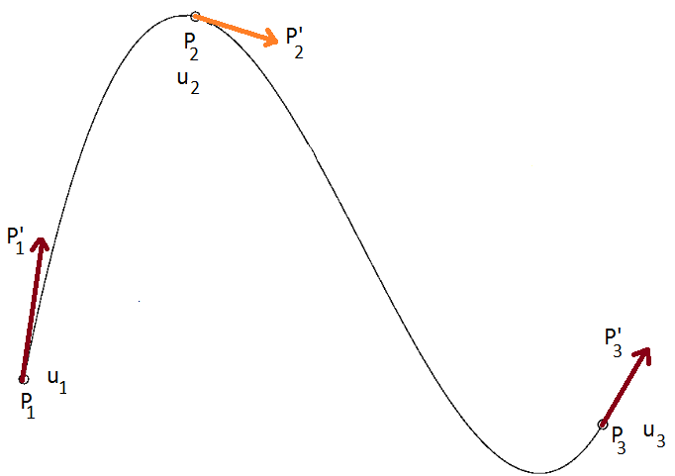
Spline Interpolation
Extend the calculation for 3 points (2 segments)
Given P₁, P₃, P₂ and P’₁, P’₃
Impractical to expect the user to provide P’₂; derive via continuity condition

Slide 22
Spline Interpolation
Extend the calculation for 3 points (2 segments)
Continuity condition
Piecewise spline of degree k has continuity of order k-1 at merging points
Polyline (spline of degree 1) has 0-order continuity (C⁰) at merging points (only positions match)
This Cubic Spline has 2-order continuity, which means P’’₂ is continuous at joint
P’’₂ is continuous at joint: left 2 points and right 2 points must give the same P’’₂

Slide 23
Spline Interpolation
Extend the calculation for 3 points (2 segments)
P’’₂ is continuous at joint: first and second segment must give the same P’’₂
Use P’’(u) = 2B₃ + 6B₄u for substitutions
P’’(u₂) = 2B₃ + 6B₄u₂ //left 2 points (1st segment from u=0 to u₂)
P’’(0) = 2B₃ //right 2 points (2nd segment from u=0 to u₃)

Slide 24
Spline Interpolation
Extend the calculation for 3 points (2 segments)
P’’₂ is continuous at joint: first and second segment must give the same P’’₂
Use P’’(u) = 2B₃ + 6B₄u for substitutions
(2B₃ + 6B₄u₂)_{seg1} = (2B₃)_{seg2}
B₃ = 3(P₂ - P₁)/u₂² - 2P’₁/u₂ - P’₂/u₂ //copied from slide20 that has P1-P2 endpoints
B₄ = 2(P₁ - P₂)/u₂³ + P’₁/u₂² + P’₂/u₂² //copied from slide20 that has P1-P2 endpns
B₃ = 3(P₃ – P₂)/u₃² - 2P’₂/u₃ - P’₃/u₃ //slid20 has P1-P2 endpoints, seg2 has P2-P3

Slide 25
Spline Interpolation
Extend the calculation for 3 points (2 segments)
P’’₂ is continuous at joint: first and second segment must give the same P’’₂
Use P’’(u) = 2B₃ + 6B₄u for substitutions
(2B₃ + 6B₄u₂)_{seg1} = (2B₃)_{seg2}
u₃P’₁ + 2(u₃ + u₂) P’₂ + u₂ P’₃ = (3/(u₂u₃))(u₂²(P₃ - P₂) + u₃²(P₂ - P₁)) = A
[u₃ 2(u₃ + u₂) u₂] [P’₁ P’₂ P’₃]^{T} = A
Compute the only unknown: P’₂
Recall P(u) = B₁ + B₂u + B₃u² + B₄u³ from slide20
Given P’₂, I can find B₁, B₂, B₃, B₄ for seg1 (and paint it with varying u)
Given P’₂, I can find B₁, B₂, B₃, B₄ for seg2 (and print it with varying u)

Slide 26
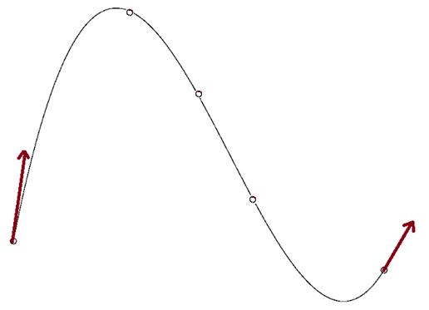
Spline Interpolation
Extend the calculation for n points (n-1 segments)
For the kth and (k+1)th segment (1 ≤ k < n-2)
[u_{k+2} 2(u_{k+2} + u_{k+1}) u_{k+1}] [P’_{k} P’_{k+1} P’_{k+2}]^{T} =
(3/(u_{k+1}u_{k+2}))(u_{k+1}²(P_{k+2} - P_{k+1}) + u_{k+2}²(P_{k+1} - P_{k}))
Compute the only unknowns: P’_{k}
Set of n-2 equations form a linear system for the tangent vectors P’_{k}

Slide 27
Spline Interpolation
Extend the calculation for n points (n-1 segments)
For the kth and (k+1)th segment (1 ≤ k < n-2)
[u_{k+2} 2(u_{k+2} + u_{k+1}) u_{k+1}] [P’_{k} P’_{k+1} P’_{k+2}]^{T} =
(3/(u_{k+1}u_{k+2}))(u_{k+1}²(P_{k+2} - P_{k+1}) + u_{k+2}²(P_{k+1} - P_{k}))
u₃ 2(u₃ + u₂) u₂ 0 …………..
0 u₄ 2(u₄ + u₃) u₃ …………..
. [P’₁ P’₂ ….. P’_{n}]^{T} = A₂
.
………………………. u_{n} 2(u_{n} + u_{n-1}) u_{n-1}
where A₂ = (3/(u₂u₃))(u₂²(P₃ - P₂) + u₃²(P₂ - P₁))
(3/(u₃u₄))(u₃²(P₄ - P₃) + u₄²(P₃ - P₂))
.
.

Slide 28
Spline Interpolation
Extend the calculation for n points (n-1 segments)
For the kth and (k+1)th segment (1 ≤ k < n-2)
[u_{k+2} 2(u_{k+2} + u_{k+1}) u_{k+1}] [P’_{k} P’_{k+1} P’_{k+2}]^{T} =
(3/(u_{k+1}u_{k+2}))(u_{k+1}²(P_{k+2} - P_{k+1}) + u_{k+2}²(P_{k+1} - P_{k}))
u₃ 2(u₃ + u₂) u₂ 0 …………..
0 u₄ 2(u₄ + u₃) u₃ …………..
. has n-2 rows vs. P’₁ to P’_{n} ☹
.
………………………. u_{n} 2(u_{n} + u_{n-1}) u_{n-1}
where A₂ = (3/(u₂u₃))(u₂²(P₃ - P₂) + u₃²(P₂ - P₁))
(3/(u₃u₄))(u₃²(P₄ - P₃) + u₄²(P₃ - P₂))
.
.

Slide 29
Spline Interpolation
Extend the calculation for n points (n-1 segments)
For the kth and (k+1)th segment (1 ≤ k < n-2)
[u_{k+2} 2(u_{k+2} + u_{k+1}) u_{k+1}] [P’_{k} P’_{k+1} P’_{k+2}]^{T} =
(3/(u_{k+1}u_{k+2}))(u_{k+1}²(P_{k+2} - P_{k+1}) + u_{k+2}²(P_{k+1} - P_{k}))
1 0 0 0 …………..
u₃ 2(u₃ + u₂) u₂ 0 …………..
0 u₄ 2(u₄ + u₃) u₃ …………..
. has n rows; compatible ☺
.
………………………. u_{n} 2(u_{n} + u_{n-1}) u_{n-1}
0 0 0 0 …………1

Slide 30
Spline Interpolation
Extend the calculation for n points (n-1 segments)
For the kth and (k+1)th segment (1 ≤ k < n-2)
[u_{k+2} 2(u_{k+2} + u_{k+1}) u_{k+1}] [P’_{k} P’_{k+1} P’_{k+2}]^{T} =
(3/(u_{k+1}u_{k+2}))(u_{k+1}²(P_{k+2} - P_{k+1}) + u_{k+2}²(P_{k+1} - P_{k}))
1 0 0 0 …………..
u₃ 2(u₃ + u₂) u₂ 0 …………..
0 u₄ 2(u₄ + u₃) u₃ …………..
. [P’₁ P’₂ ….. P’_{n}]^{T} = A₃
.
………………………. u_{n} 2(u_{n} + u_{n-1}) u_{n-1}
0 0 0 0 …………1
where A₃ = P’₁
(3/(u₂u₃))(u₂²(P₃ - P₂) + u₃²(P₂ - P₁))
(3/(u₃u₄))(u₃²(P₄ - P₃) + u₄²(P₃ - P₂)) can be done since P’₁ and P’_{n} are known
.
P’_{n}

Slide 31
Spline Interpolation
Extend the calculation for n points (n-1 segments)
For the kth and (k+1)th segment (1 ≤ k < n-2)
[u_{k+2} 2(u_{k+2} + u_{k+1}) u_{k+1}] [P’_{k} P’_{k+1} P’_{k+2}]^{T} =
(3/(u_{k+1}u_{k+2}))(u_{k+1}²(P_{k+2} - P_{k+1}) + u_{k+2}²(P_{k+1} - P_{k}))
1 0 0 0 …………..
u₃ 2(u₃ + u₂) u₂ 0 …………..
0 u₄ 2(u₄ + u₃) u₃ …………..
. [P’₁ P’₂ ….. P’_{n}]^{T} = A₃
.
………………………. u_{n} 2(u_{n} + u_{n-1}) u_{n-1}
0 0 0 0 …………1
This is a strictly diagonally dominant matrix, hence non-singular
This is a tridiagonal matrix, hence fast to invert (O(n) instead of O(n³))
Moving any point P_{k} will change the entire curve (‘cos A₃ will change)

Slide 32
Spline Interpolation
Extend the calculation for n points (n-1 segments)
Recall P_{k}(u) = B_{1k} + B_{2k}u + B_{3k}u² + B_{4k}u³ for one (kth) segment
Solving for B_{1k}, B_{2k}, B_{3k}, B_{4k} for kth segment
B_{1k} = P_{k}
B_{2k} = P’_{k}
B_{3k} = 3(P_{k+1} - P_{k})/u_{k+1}² - 2P’_{k}/u_{k+1} - P’_{k+1}/u_{k+1}
B_{4k} = 2(P_{k} - P_{k+1})/u_{k+1}³ + P’_{k}/u_{k+1}² + P’_{k+1}/u_{k+1}²
Ingredients
All positions P_{k} are provided by user
All tangent vectors P’_{k} are computed (except P’₀ and P’_{n} given by user)
Using this ingredients, we can now draw the kth segment ☺
Let’s rearrange B_{ik} above to eventually obtain the Blending Functions

Slide 33
Spline Interpolation
Blending functions
Recall P_{k}(u) = B_{1k} + B_{2k}u + B_{3k}u² + B_{4k}u³ for one (kth) segment
B_{1k} 1 0 0 0 P_{k}
B_{2k} = 0 1 0 0 P’_{k}
B_{3k} -3/u_{k+1}² -2/u_{k+1}² 3/u_{k+1}² -1/u_{k+1} P_{k+1}
B_{4k} 2/u_{k+1}³ 1/u_{k+1}² -2/u_{k+1}³ 1/u_{k+1}² P’_{k+1}
P_{k}(u) = B_{1k} + B_{2k}u + B_{3k}u² + B_{4k}u³ for 1 ≤ k < n-1 and 0 ≤ u ≤ u_{k+1}
1st segment (k=1) from u=0 to u₂, 2nd segment from u=0 to u₃, and so on
Typically u_{k}=1 (called Normalized Spline), but better methods possible (see slide41)
P_{k}(u) = [1 u u² u³] [B_{1k} B_{2k} B_{3k} B_{4k}]^{T}
Replace [B_{1k} B_{2k} B_{3k} B_{4k}]^{T} using the identity above

Slide 34
Spline Interpolation
Blending functions
Recall P_{k}(u) = B_{1k} + B_{2k}u + B_{3k}u² + B_{4k}u³ for one (kth) segment
1 0 0 0 P_{k}
P_{k}(u) = [1 u u² u³] 0 1 0 0 P’_{k}
-3/u_{k+1}² -2/u_{k+1}² 3/u_{k+1}² -1/u_{k+1} P_{k+1}
2/u_{k+1}³ 1/u_{k+1}² -2/u_{k+1}³ 1/u_{k+1}² P’_{k+1}
P_{k}(u) = [1 - 3u²/u_{k+1}² + 2u³/u_{k+1}³ u - 2u²/u_{k+1}² + u³ /u_{k+1}²
3u²/u_{k+1}² - 2u³/u_{k+1}³ - u²/u_{k+1} + u³/u_{k+1}² ] P_{k}
P’_{k}
P_{k+1}
P’_{k+1}

Slide 35
Spline Interpolation
Blending functions
Recall P_{k}(u) = B_{1k} + B_{2k}u + B_{3k}u² + B_{4k}u³ for one (kth) segment
Substitute t = u/u_{k+1} and rearrange
P_{k}(u) = [F₁(t) F₂(t) F₃(t) F₄(t)] [P_{k} P_{k+1} P’_{k} P’_{k+1}]^{T}
0 ≤ t ≤ 1 and 1 ≤ k ≤ n-1
F₁(t) = 2t³ - 3t² + 1
F₂(t) = -2t³ + 3t²
F₃(t) = t(t² -2t + 1)u_{k+1}
F₄(t) = t(t² - 1)u_{k+1}
F₁, F₂, F₃, F₄ are called Blending Functions
Blending functions blend geometry (position and tangent) [P_{k} P’_{k} P_{k+1} P’_{k+1}]^{T}

Slide 36
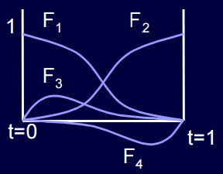
Spline Interpolation
Blending functions
Recall P_{k}(u) = B_{1k} + B_{2k}u + B_{3k}u² + B_{4k}u³ for one (kth) segment
P_{k}(u) = [F][G] where G is the geometric information
P_{k}(u) = [F₁(t) F₂(t) F₃(t) F₄(t)] [P_{k} P_{k+1} P’_{k} P’_{k+1}]^{T}
F₁(0)=1, F₂(0)=0, F₃(0)=0, F₄(0)=0 curve passes P1
F₁(1)=0, F₂(1)=1, F₃(1)=0, F₄(1)=0 curve passes P2
F₂=1-F₁, F₄=1-F₃
Relative magnitudes of F₁,F₂ > F₃,F₄ //more influential on positions

Slide 37
Normalized Cubic Splines
Extend the calculation for n points (n-1 segments)
Normalized cubic splines are obtained when u_{k}=1 for all k
We then have the following constant matrix to invert
1 0 0 0 …………..
1 4 1 0 …………..
0 1 4 1 …………..
. [P’₁ P’₂ ….. P’_{n}]^{T} = A₄
.
………………………. 1 4 1
0 0 0 0 …………1
where A₄ = P’₁
3(P₃ - P₂) + (P₂ - P₁)
3(P₄ - P₃) + (P₃ - P₂)
.
P’_{n}

Slide 38
Normalized Cubic Splines
Extend the calculation for n points (n-1 segments)
Normalized cubic splines are obtained when u_{k}=1 for all k
Blending functions reduce to something called Hermite Polynomial Blending Functions
F₁(t) = 2t³ - 3t² + 1
F₂(t) = -2t³ + 3t²
F₃(t) = t(t² -2t + 1)
F₄(t) = t(t² - 1)

Slide 39
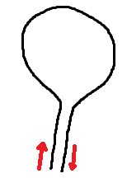
Natural Cubic Splines
Extend the calculation for n points (n-1 segments)
Aka Relaxed Cubic Splines
Natural Cubic Spline is a Cubic Spline that has second derivative equal to 0 at the endpoints
P’’₁(0) = P’’_{n-1}(u_{n-1}) = 0
Other special Cubic Splines
Clamped: P’₁ and P’_{n} are given (we considered this case)
Cyclic: 2 ends match in 1st and 2nd derivatives; P’’₁(0)=P’’_{n-1}(u_{n-1}) & P’₁(0)=P’_{n-1}(u_{n-1})
Closed curve
Anticyclic: 2 ends negate in 1st and 2nd derv; P’’₁(0)=-P’’_{n-1}(u_{n-1}) & P’₁(0)=-P’_{n-1}(u_{n-1})
Squash racket design

Slide 40
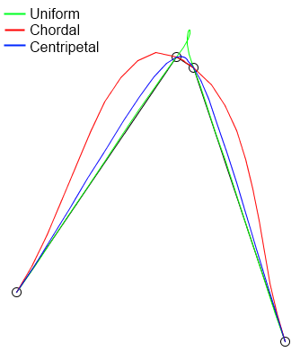
Spline Parametrization
Splines we discussed so far are also known as Catmull-Rom splines
Their behaviour depends on the choice of parameters u_{k} at the control points P_{k}
Uniform parametrization: u_{k} = 1 (Normalized Cubic Splines, aka standard or uniform Catmull-Rom spline)
Chordal parametrization: u_{k} ~ ||P_{k-1} – P_{k}|| (chordal CatmullRom spline)
Centripetal parametrization: u_{k} ~ ||P_{k-1} - P_{k}||^{0.5} (centripetal Catmull-Rom spline)

Slide 41
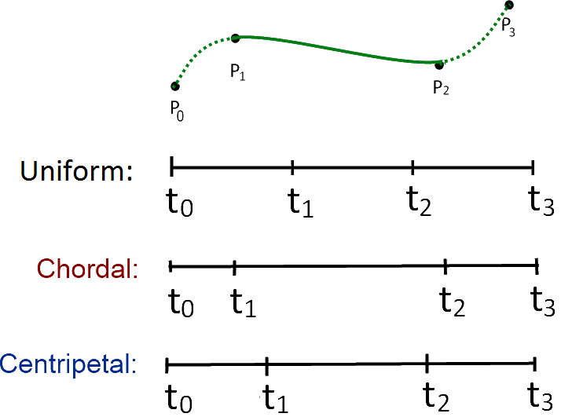
Spline Parametrization
All from the same family: ||P_{k-1} - P_{k}||^{α}
Uniform: u_{k} = ||P_{k-1} - P_{k}||⁰
Chordal: u_{k} ~ ||P_{k-1} - P_{k}||¹
Centripetal: u_{k} ~ ||P_{k-1} - P_{k}||^{0.5} (best)
Will not form loop or self-intersection within a curve segment
Cusp will never occur within a curve segment
Spline follows the control points more tightly

Slide 42
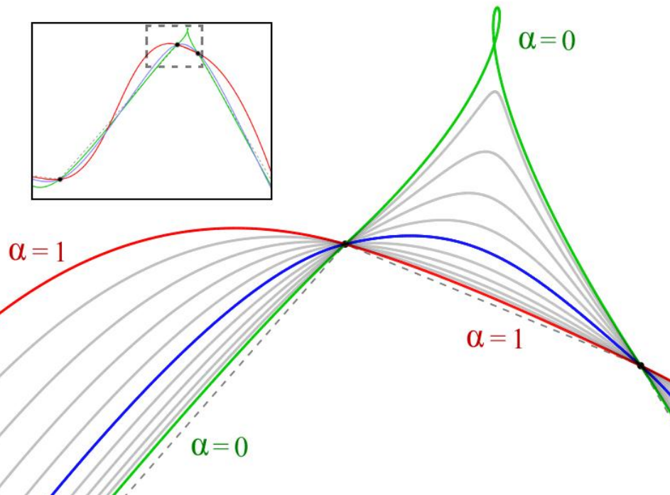
Spline Parametrization
All from the same family: ||P_{k-1} - P_{k}||^{α}

Slide 43
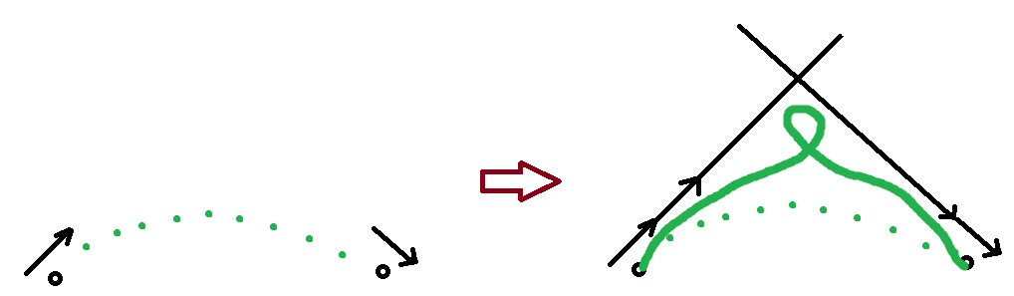
Spline Parametrization
Loop arises if the tangent vectors are too powerful (right)
Loop does not violate continuity condition, hence possible

Slide 44
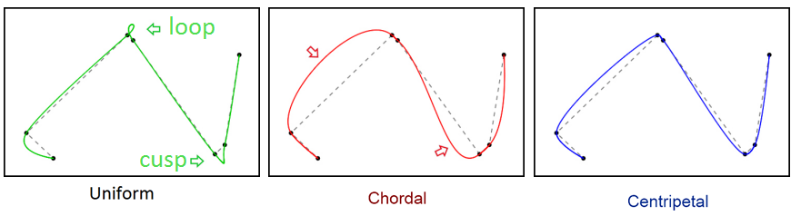
Spline Parametrization
All from the same family: ||P_{k-1} - P_{k}||^{α}
Uniform parameterization overshoots and often generates cusps and intersections within short curve segments
Chordal has the same problems for longer segments
Centripetal is guaranteed to be loop/intersection-free and cusp-free and does not suffer from overshooting (tight)

Slide 45
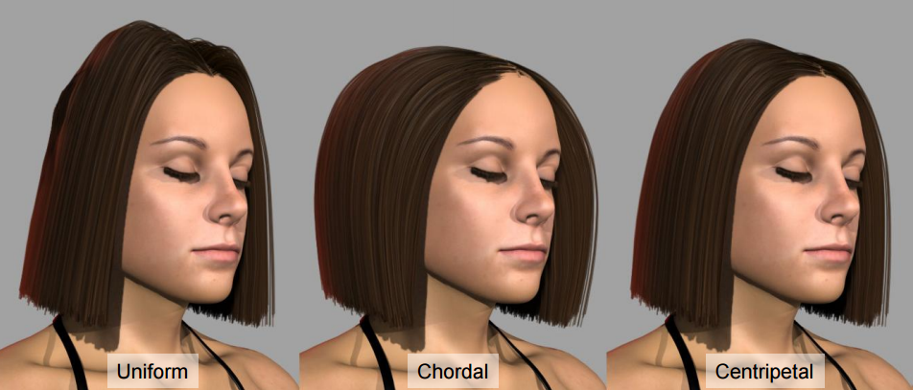
Spline Parametrization
All from the same family: ||P_{k-1} - P_{k}||^{α}
A hair design application of splines (from Hair Meshes paper, 2009)

Slide 46
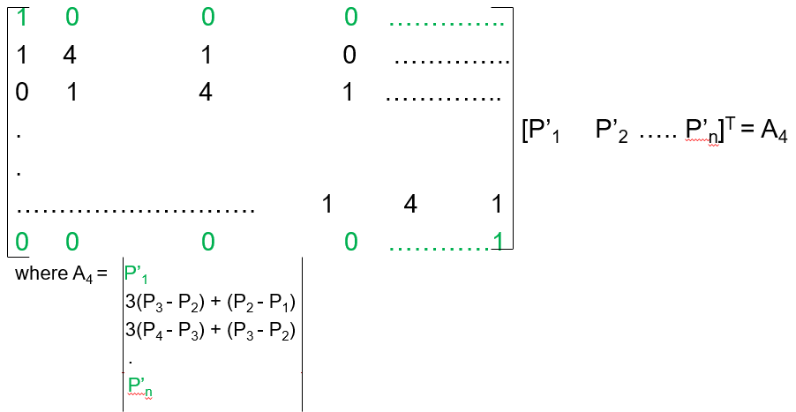
Cubic Hermite Splines
Same as the Normalized Cubic Splines, except the tangent vectors are also provided for each position
Recall that tangent vectors are computed (not provided) based on the second derivation equality condition in Normalized Cubic Splines
Tangents of 2 endpoints of the spline can be provided in the Clamped version
Availability of tangent vectors save us from building nxn matrices of the Normalized Cubic Spline case
We will instead have local 4x4 matrices per segment which avoids local-change global-update limitation of the Normalized Cubic Spline
Moving any point P_{k} in
a Natural Cubic Spline will
change the entire curve
(‘cos A₄ will change)

Slide 47
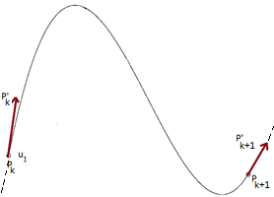
Cubic Hermite Splines
Calculation of a cubic spline
Given P_{k}, P_{k+1}, and P’_{k}, P’_{k+1}
P(0) = P_{k} P’(0) = P’_{k}
P(1) = P_{k+1} P’(1) = P’_{k+1}
Use P(u) = B₁ + B₂u + B₃u² + B₄u³ for substitutions
P(0) = B₁ = P_{k}
P(1) = B₁ + B₂ + B₃ + B₄ = P_{k+1}
Use P’(u) = B₂ + 2B₃u + 3B₄u² for substitutions
P’(0) = B₂ = P’_{k}
P’(1) = B₂ + 2B₃ + 3B₄ = P_{k+1}

Slide 48
Cubic Hermite Splines
Calculation of a cubic spline
Need B_{i} (from P(u) = B₁ + B₂u + B₃u² + B₄u³)
to draw the curve segment
P(0) = B₁ = P_{k}
P(1) = B₁ + B₂ + B₃ + B₄ = P_{k+1}
P’(0) = B₂ = P’_{k}
P’(1) = B₂ + 2B₃ + 3B₄ = P_{k+1}
P_{k} 0 0 0 1 B₄
P_{k+1} = 1 1 1 1 B₃
P’_{k} 0 0 1 0 B₂
P’_{k+1} 3 2 1 0 B₁

Slide 49
Cubic Hermite Splines
Calculation of a cubic spline
Need B_{i} (from P(u) = B₁ + B₂u + B₃u² + B₄u³)
to draw the curve segment
P(0) = B₁ = P_{k}
P(1) = B₁ + B₂ + B₃ + B₄ = P_{k+1}
P’(0) = B₂ = P’_{k}
P’(1) = B₂ + 2B₃ + 3B₄ = P_{k+1}
B₄ 0 0 0 1 P_{k}
B₃ = 1 1 1 1 P_{k+1}
B₂ 0 0 1 0 P’_{k}
B₁ 3 2 1 0 P’_{k+1}
-1

Slide 50
Cubic Hermite Splines
Calculation of a cubic spline
Need B_{i} (from P(u) = B₁ + B₂u + B₃u² + B₄u³)
to draw the curve segment
P(0) = B₁ = P_{k}
P(1) = B₁ + B₂ + B₃ + B₄ = P_{k+1}
P’(0) = B₂ = P’_{k}
P’(1) = B₂ + 2B₃ + 3B₄ = P_{k+1}
B₄ 2 -2 1 1 P_{k}
B₃ = -3 3 -2 -1 P_{k+1} All B_{i} found using the known P & P’ values ☺
B₂ 0 0 1 0 P’_{k}
B₁ 1 0 0 0 P’_{k+1}
Known as
Hermite Basis Matrix

Slide 51
Cubic Hermite Splines
Calculation of a cubic spline
Rewrite P(u) to derive Hermite Blending Functions
P(u) = [u³ u² u 1] [B₄ B₃ B₂ B₁]^{T}
= [u³ u² u 1] 2 -2 1 1 P_{k}
-3 3 -2 -1 P_{k+1}
0 0 1 0 P’_{k}
1 0 0 0 P’_{k+1}
P(u) =
P_{k} (2u³ - 3u² + 1) + P_{k+1} (-2u³ + 3u²) + P’_{k} (u³ - 2u² + u) + P’_{k+1} (u³ - u²)
These polynomials are called Hermite Blending Functions (tells us how to blend the geometric (position and tangent) boundary conditions to generate the position of a point P(u) on the curve).

Slide 52
Cubic Hermite Splines
Note that Hermite Blending Functions are exactly the Normalized Cubic Spline blending functions (slide 38)
Thanks to the 4x4 local Hermite Basis Matrix per segment, we observe only local changes in a Hermite Spline, i.e., only the neighborhood of the updated point is affected, not the all global spline

Slide 53
Bezier Curves
So far our splines pass through the control points: interpolation
Now they will pass close to the control points: approximation
Bezier curves is the most famous approximation curve
Not a spline as there is no curve segments here; in fact locally changing one point affects the whole curve globally
Introduced by Pierre Bezier from Renault Automobiles
Interpolated
Approximated

Slide 54
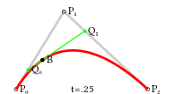
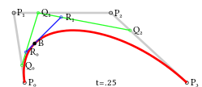
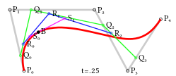
Bezier Curves
Essentially it replaces the tangent vectors of cubic splines, that exist virtually but not quite visually, with supporting points from which curve does not pass
A quadratic Bezier curve A cubic Bezier curve A quartic Bezier curve

Slide 55
Bezier Curves
Hence the motivation is to design curves that are easy to specify
Input is just the point locations P_{k}
A quadratic Bezier curve A cubic Bezier curve A quartic Bezier curve

Slide 56
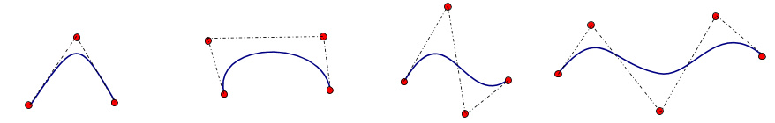
Bezier Curves
Hence the motivation is to design curves that are easy to specify
Bezier curve captures the shape specified by control points
Quadratic and cubic Bezier curves are the most common
Higher degree curvs are more computationally expensive to evaluate
When more complex shapes are needed, low order Bezier curves are merged together, producing a composite Bezier curve or Bezier spline

Slide 57
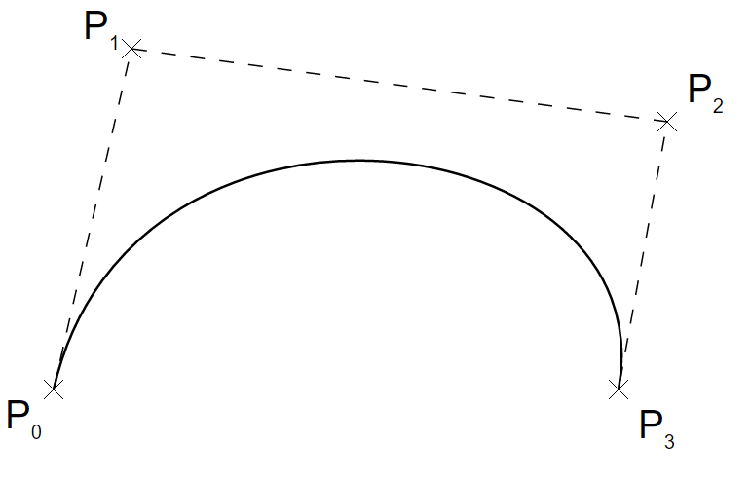
Bezier Curves
Hence the motivation is to design curves that are easy to specify
Bezier curve captures the shape specified by control points P_{k}
P(u) = Σ₀ P_{i} J_{i}^{n}(u) where 0 ≤ u ≤ 1 and J_{i}^{n}(u) are called Bernstein basis/blending functions
_{n}

Slide 58
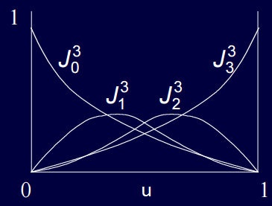
Bernstein Polynomials
J_{i}^{n}(u) are the Bernstein basis/blending functions or polynomials
J_{i}^{n}(u) = C(n, i)u^{i}(1-u)^{n-i} where C(n, i) = n! / (i!(n-i)!)
J₀⁰(u) = 1
J_{i}^{n}(u) = 0 for i < 0 or i > n
Σ₀ J_{i}^{n}(u) = 1
J_{i}^{n}(u) ≥ 0 for 0 ≤ u ≤ 1
For cubic Bezier n = 3 and we have:
_{n}

Slide 59
Bernstein Polynomials
J_{i}^{n}(u) are the Bernstein basis/blending functions or polynomials
J_{i}^{n}(u) = C(n, i)u^{i}(1-u)^{n-i} where C(n, i) = n! / (i!(n-i)!)
For cubic Bezier n = 3 and we have:
J₀³(u) = u⁰(1-u)³ = (1-u)³
J₁³(u) = 3u(1-u)³
J₂³(u) = 3u²(1-u)
J₃³(u) = u³
P(u) = P₀J₀³ + P₁J₁³ + P₂J₂³ + P₃J₃³

Slide 60
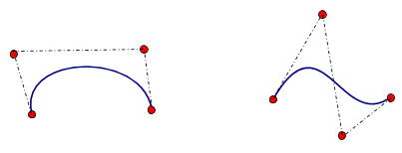
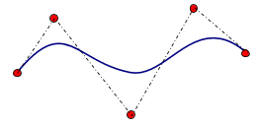
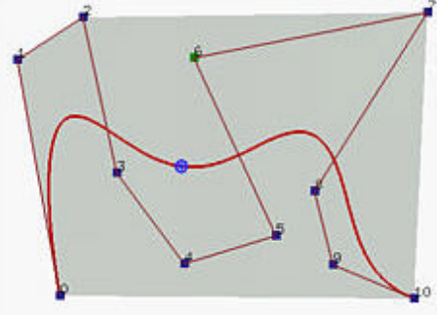
Bezier Curve
Degree/order of the Bezier curve is # of control points minus 1
Degree 3 (cubic)
Degree 4 (quartic)
Degree 10 (11 control points)

Slide 61
Bezier Curve
End point interpolation property
Bezier curve (of any degree) interpolates the 2 endpoints (passes through)
Recall J_{i}^{n}(u) = C(n, i)u^{i}(1-u)^{n-i}
At u=0 (first endpoint)
i = 0, J₀^{n}(0) = C(n, 0)u⁰(1-u)^{n-0} = 1
i ≠ 0, J_{i}^{n}(0) = C(n, i)0^{i}(1-0)^{n-i} = 0
P(0) = P₀J₀^{n}(0) = P₀

Slide 62
Bezier Curve
End point interpolation property
Bezier curve (of any degree) interpolates the 2 endpoints (passes through)
Recall J_{i}^{n}(u) = C(n, i)u^{i}(1-u)^{n-i}
At u=1 (second endpoint)
i = n, J_{n}^{n}(1) = C(n, n)1^{n}(1-u)⁰ = 1
i ≠ n, J_{i}^{n}(1) = C(n, i)1^{i}(1-1)^{n-i} = 0
P(1) = P_{n}J_{n}^{n}(1) = P_{n}

Slide 63
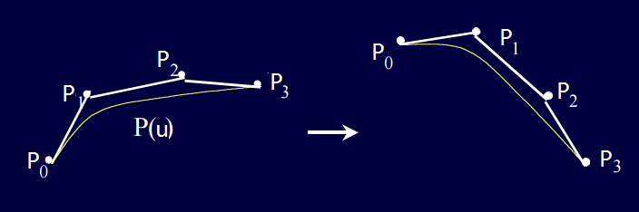
Bezier Curve
Affine invariance property
Applying an affine transformation M to the curve is equivalent to applying the transformation to the control points, and vice versa
Useful property because it says it is enough to transform the control points

Slide 64
Bezier Curve
Affine invariance property
Applying an affine transformation M to the curve is equivalent to applying the transformation to the control points, and vice versa
Useful property because it says it is enough to transform the control points
Recall P(u) = Σ₀ P_{i} J_{i}^{n}(u) where Σ₀ J_{i}^{n}(u) = 1
Mx = Rx + t //rotation R and translation t applied to curve points x
M (Σ_{i}a_{i}b_{i}) = R (Σ_{i}a_{i}b_{i}) + t //rewrite the curve in Bernstein_{i} * Point_{i} form
= Σ_{i}a_{i}Rb_{i} + Σ_{i}a_{i}t //due to red identity
= Σ_{i}a_{i} (Rb_{i} + t)
= Σ_{i}a_{i} Mb_{i}
_{n}
_{n}

Slide 65
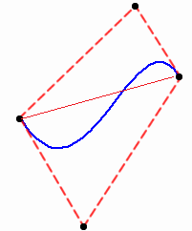
Bezier Curve
Convex hull property
Bezier curve lies in the convex hull of the control points P_{k}
Useful property because intersection/collision computation of one curve with another (or anything designed with this curve) is accelerated by pruning

Slide 66
Bezier Curve
Convex hull property
Bezier curve lies in the convex hull of the control points P_{k}
Useful property because intersection/collision computation of one curve with another (or anything designed with this curve) is accelerated by pruning
Follows from the properties of Bernstein polynomials:
Σ₀ J_{i}^{n}(u) = 1
J_{i}^{n}(u) ≥ 0 for 0 ≤ u ≤ 1 //barycentric coordinates idea once you triangulate the hull
Bezier curve is a convex combination of its control points: P(u) = Σ₀ J_{i}^{n}(u)P_{i}
_{n}
_{n}

Slide 67
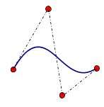
Bezier Curve
Symmetry property
P(u) defined by P₀, P₁, .., P_{n} is equal to P(1-u) defined by P_{n}, P_{n-1}, .., P₀
Σ₀ P_{i}J_{i}^{n}(u) = Σ₀ P_{n-i}J_{i}^{n}(1-u)
_{n}
_{n}

Slide 68
Bezier Curve
Domain parameter transformation property
So far u is in [0, 1]
We can use a different domain captured by t in [a, b]
u = (t-a) / (b-a)
Σ₀ P_{i}J_{i}^{n}(u) = Σ₀ P_{i}J_{i}^{n}((t-a) / (b-a))
_{n}
_{n}

Slide 69
Bezier Curve
Pseudo-local control property
Moving any point will change the entire curve (by definition P(u) = Σ₀ J_{i}^{n}(u)P_{i})
But there is a local influence of P_{i} captured by the Bernstein J_{i}^{n}
If you move P₂ the max influence is going to be observed at u =2/3 = 0.66
Local control with respect to each of the control points we have
J_{i}^{n}(u) has only one max at u = i/n
_{n}

Slide 70
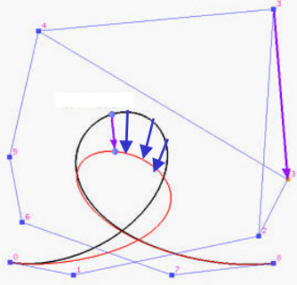
Bezier Curve
Pseudo-local control property
Moving any point will change the entire curve (by definition P(u) = Σ₀ J_{i}^{n}(u)P_{i})
But there is a local influence of P_{i} captured by the Bernstein J_{i}^{n}
If you move P₂ the max influence is going to be observed at u =2/3 = 0.66
Local control with respect to each of the control points we have
Changing one point (P₃) affects the whole curve (more effect around P₃)
Global change is a limitation ☹
_{n}

Slide 71
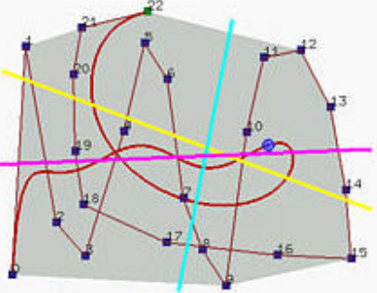
Bezier Curve
Variation diminishing property
The kind of twists and turns offered by the control polyline is a maximum; the curve may follow it will be less than or equal to that
So the variations are diminishing
No straight line intersects a Bezier curve more times than it intersects the curve's control polyline
What if the control polygon is convex?
Max intersection is 2 times; that is what I have with the generated curve
Asserts the convexity

Slide 72
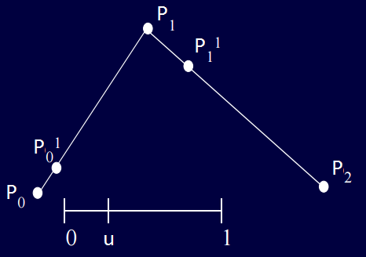
Bezier Curve
Construction by de Casteljau Algorithm
Idea: repetitive linear interpolation
P₀¹(u) = (1-u)P₀ + uP₁ P₁¹(u) = (1-u)P₁ + uP₂

Slide 73
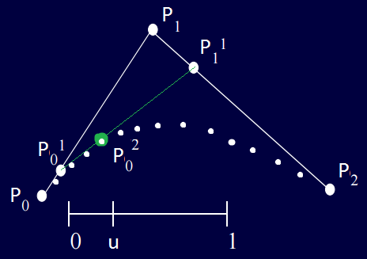
Bezier Curve
Construction by de Casteljau Algorithm
Idea: repetitive linear interpolation
P₀¹(u) = (1-u)P₀ + uP₁ P₁¹(u) = (1-u)P₁ + uP₂
P₀²(u) = (1-u)P₀¹(u) + uP₁¹(u) = (1-u)²P₀ + 2u(1-u)P₁ + u²P₂

Slide 74
Bezier Curve
Construction by de Casteljau Algorithm
Idea: repetitive linear interpolation
P₀¹(u) = (1-u)P₀ + uP₁ P₁¹(u) = (1-u)P₁ + uP₂
P₀²(u) = (1-u)P₀¹(u) + uP₁¹(u) = (1-u)²P₀ + 2u(1-u)P₁ + u²P₂
Bernstein polynomials of degree 2; so what I get is a Bezier curve ☺

Slide 75
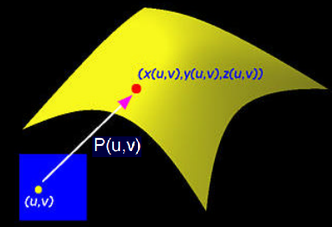
Parametric Surfaces
Boundary representation of objects
Useful in modeling, rendering, simulation, ..
P(u, v) = (x(u,v), y(u,v), z(u,v))
An obvious extension of parametric curves (P(u) with 1 parameter → (u,v) params)
P(u) = B₁ + B₂u + B₃u² + B₄u³ for a cubic spline, for instance
x(u) = B_{1x} + B_{2x}u + B_{3x}u² + B_{4x}u³
y(u) = B_{1y} + B_{2y}u + B_{3y}u² + B_{4y}u³
z(u) = B_{1z} + B_{2z}u + B_{3z}u² + B_{4z}u³

Slide 76
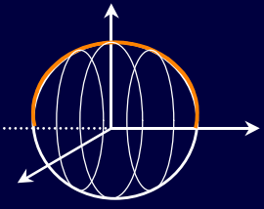
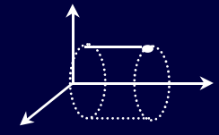
Parametric Surfaces
Boundary representation of objects
Parametrizing mathematical boundaries is easy
Transforming a 2D entity (profile) about an axis
Sphere
Semicircle
Rotate
Cylinder
Circle
Translate

Slide 77
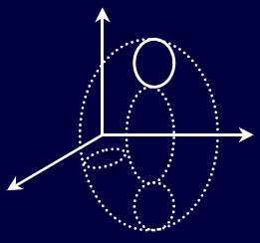
Parametric Surfaces
Boundary representation of objects
Parametrizing mathematical boundaries is easy
Transforming a 2D entity (profile) about an axis
Sphere
Semicircle
Rotate
Torus
Circle
Rotate

Slide 78

Parametric Surfaces
Boundary representation of objects
Parametrizing mathematical boundaries is easy
Transforming a 2D entity (profile) about an axis
Sphere
Semicircle
Rotate
Cone
Circle
Translate
Scale

Slide 79
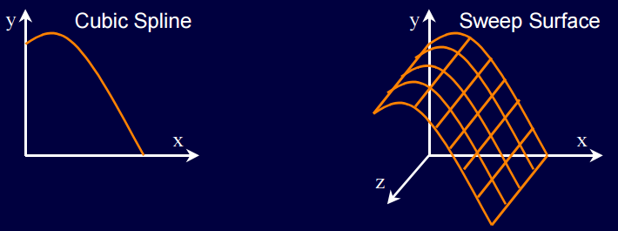
Parametric Surfaces
Boundary representation of objects
Parametrizing arbitrary boundaries is similar
What we have done with mathematical shapes is we performed a sweep of a 2D entity parametrized by 1 parameter: P(u)
Circle, semicircle
We obtain an arbitrary boundary by sweeping P(u) as some spline or any other parametric curve

Slide 80
Parametric Surfaces
Boundary representation of objects
Parametrizing arbitrary boundaries with sweeping is valid as long as you have a fixed profile/contour
Not so arbitrary ☹
A more flexible way is to extend linear interpolation (P(u)) into bilinear interpolation (P(u, v))

Slide 81
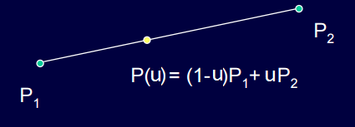
Parametric Surfaces
Boundary representation of objects
Linear interpolation fits the simplest curve between two end points

Slide 82
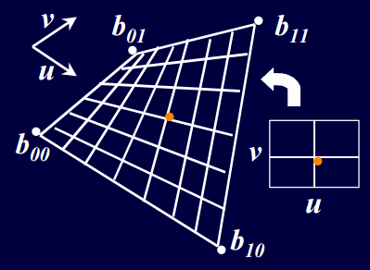
Parametric Surfaces
Boundary representation of objects
Bilinear interpolation fits the simplest surface for the four corner points

Slide 83
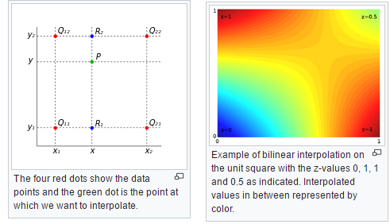
Parametric Surfaces
Boundary representation of objects
Bilinear interpolation is 2-pass linear interpolation
From wikipedia

Slide 84
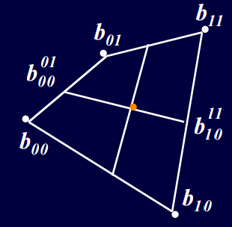
Parametric Surfaces
Boundary representation of objects
Bilinear interpolation is 2-pass linear interpolation
Given 4 corner points in space (not necessarily coplanar)
Parameter v brings us here (b0001) and there (b1011)
Parameter u brings us here (P(u, v))
b0001 = (1-v)b₀₀ + vb₀₁ b1011 = (1-v)b₁₀ + vb₁₁
P(u, v) = (1-u)b0001 + ub1011

Slide 85
Parametric Surfaces
Boundary representation of objects
Bilinear interpolation is 2-pass linear interpolation
Given 4 corner points in space (not necessarily coplanar)
Parameter v brings us here (b0001) and there (b1011)
Parameter u brings us here (P(u, v))
P(u, v) = [1-u u] b₀₀ b₀₁ [1-v v]^{T}
b₁₀ b₁₁

Slide 86
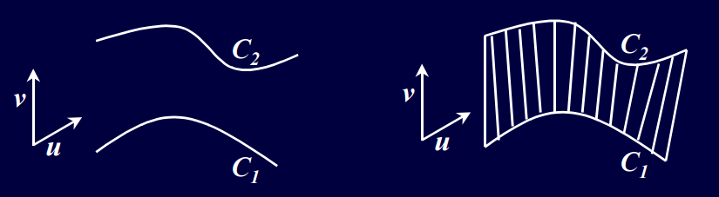
Parametric Surfaces
Boundary representation of objects
To be even more flexible, connect corner points with curves, not lines
P(u, 0) = C₁(u) P(u, 1) = C₂(u)
P(u, v) = (1-v) C₁(u) + v C₂(u)
= (1-v) P(u,0) + v P(u, 1)
For constant u iso-parametric curve is a line

Slide 87
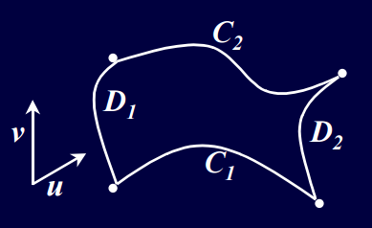
Parametric Surfaces
Boundary representation of objects
To be even more flexible, connect corner points with curves, not lines
P(u, 0) = C₁(u) P(u, 1) = C₂(u)
P(0, v) = D₁(v) P(1, v) = D₂(v)

Slide 88
Bezier Surface
Yet another Parametric Surface to represent the boundary of objects
Bezier surface
Given the parameter u and v, where is the corresponding point in the surface?

Slide 89
Bezier Curve (Revisit)
Construction by de Casteljau Algorithm
Idea: repetitive linear interpolation
P₀¹(u) = (1-u)P₀ + uP₁ P₁¹(u) = (1-u)P₁ + uP₂
P₀²(u) = (1-u)P₀¹(u) + uP₁¹(u) = (1-u)²P₀ + 2u(1-u)P₁ + u²P₂

Slide 90
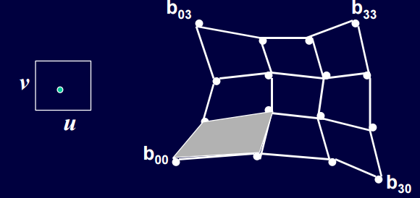
Bezier Surface
Construction by de Casteljau Algorithm
Idea: repetitive bilinear interpolation
Just the way we have control points for the curves (red, green), we can run de Casteljau algorithm on control points for surface (whites)
Cubic in v
Cubic in u

Slide 91
Bezier Surface
Construction by de Casteljau Algorithm
Idea: repetitive bilinear interpolation
Parameter v brings us here (b0001) and there (b1011)
Parameter u brings us here (P(u, v))
P(u, v) = [1-u u] b₀₀ b₀₁ [1-v v]^{T}
b₁₀ b₁₁

Slide 92
Bezier Surface
Construction by de Casteljau Algorithm
Idea: repetitive bilinear interpolation
b0011 = [1-u u] b₀₀ b₀₁ [1-v v]^{T}
b₁₀ b₁₁

Slide 93
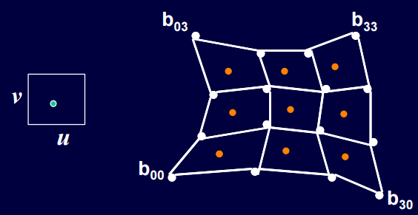
Bezier Surface
Construction by de Casteljau Algorithm
Idea: repetitive bilinear interpolation
This is one level of bilinear interpolation

Slide 94
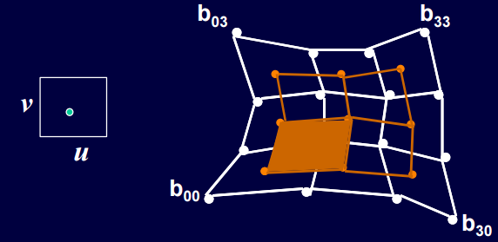
Bezier Surface
Construction by de Casteljau Algorithm
Idea: repetitive bilinear interpolation
This is two levels of bilinear interpolation
b0022 = [1-u u] b0011 b0111 [1-v v]^{T}
b1011 b1111

Slide 95

Bezier Surface
Construction by de Casteljau Algorithm
Idea: repetitive bilinear interpolation
This is three levels of bilinear interpolation
b0033 = [1-u u] b0022 b0122 [1-v v]^{T}
b1022 b1122

Slide 96

Bezier Surface
Construction by de Casteljau Algorithm
Idea: repetitive bilinear interpolation
This is three levels of bilinear interpolation
b0033 is located as point on the surface

Slide 97

Bezier Surface
Construction by de Casteljau Algorithm
Idea: repetitive bilinear interpolation
Problem: green part is just a line, not a patch ☹
de Casteljau has a problem if degree of u is different from degree of v
Need to implement special cases
A better way around this is to use Bernstein polynomials’ Cartesian product
With this way u and v with same and different degrees will be handled in a natural way

Slide 98

Bezier Surface
Construction by Bernstein polynomials’ Cartesian product
Idea: A surface can be thought of as being swept out by a moving and deforming curve

Slide 99


Bezier Surface
Construction by Bernstein polynomials’ Cartesian product
Idea: A surface can be thought of as being swept out by a moving and deforming curve
Control points of one Bezier curve will traverse along another Bezier curve
n ≠ m in general

Slide 100
Bezier Surface
Construction by Bernstein polynomials’ Cartesian product
Idea: A surface can be thought of as being swept out by a moving and deforming curve
Control points of u-Bezier curve will traverse along v-Bezier curve
Bezier surface is made of many curves
going along either the u or v direction
If we move along the v direction, the curves
defined by the points 1,5,9,13 & 2,6,10,14
(and so on) need to be interpolated
To perform this interpolation, use the control
points traversed over other Bezier curves
defined by the points 1,2,3,4 & 5,6,7,8 (and so on)

Slide 101

Bezier Surface
Construction by Bernstein polynomials’ Cartesian product
Idea: A surface can be thought of as being swept out by a moving and deforming curve
Control points of u-Bezier curve will traverse along v-Bezier curve
Bezier surface is made of many curves
going along either the u or v direction
To perform this interpolation, use the control
points traversed over other Bezier curves
Other curves visualized here as the yellow ones
One particular v gives the 4 green control points
The next v gives the orange control points that
define the next interpolation b/w 1,5,9,13 & 2,6,10,14

Slide 102

Bezier Surface
Construction by Bernstein polynomials’ Cartesian product
Idea: A surface can be thought of as being swept out by a moving and deforming curve
Control points of u-Bezier curve will traverse along v-Bezier curve
Bezier surface is made of many curves
going along either the u or v direction
In the end I have these
surface curves
along the v direction

Slide 103

Bezier Surface
Construction by Bernstein polynomials’ Cartesian product
Idea: A surface can be thought of as being swept out by a moving and deforming curve
Control points of u-Bezier curve will traverse along v-Bezier curve
Bezier surface is made of many curves
going along either the u or v direction
Do the same operation
along the u direction
to obtain quads on the
surface, which can
then be rendered (or
triangulated)

Slide 104


Bezier Surface
Construction by Bernstein polynomials’ Cartesian product
Mathematically, we are performing a Cartesian product of Bezier pairs
Let the sweep curve along v direction be
Σ_{i=0} P_{i} J_{i}^{n}(u) //red curves (defined by u)
P₀ = 1(u=0,v=0), P₁ = 5(u=0.33, v=0), P₂ = 9(u=0.66, v=0), P₃ = 13(u=1,v=0)
P₀= (u=0,v=.33), P₁= (u=0.33, v=0.33), P₂= (u=0.66, v=0.33), P₄= (u=1,v=0.33)
Each control point P_{i} traverses a Bezier curve
along u direction
P_{i} = P_{i}(v) = Σ_{j=0} P_{ij} J_{j}^{m}(v) //yellow curves (defined by v)
Here P_{ij} = 1,2,3,4(i=0) & 5,6,7,8(i=1) and so on
_{n}
_{m}

Slide 105
Bezier Surface
Construction by Bernstein polynomials’ Cartesian product
Mathematically, we are performing a Cartesian product of Bezier pairs
Let the sweep curve along v direction be
Σ_{i=0} P_{i} J_{i}^{n}(u) //red curves
P_{i} = P_{i}(v) = Σ_{j=0} P_{ij} J_{j}^{m}(v)
Substitute P_{i} in swept curve to get:
P(u,v) = Σ_{i=0} Σ_{j=0} P_{ij} J_{j}^{m}(v) J_{i}^{n}(u)
_{n}
_{m}
_{n}
_{m}

Slide 106
Bezier Surface
Construction by Bernstein polynomials’ Cartesian product
Mathematically, we are performing a Cartesian product of Bezier pairs
P(u,v) = Σ_{i=0} Σ_{j=0} P_{ij} J_{j}^{m}(v)J_{i}^{n}(u) in matrix form:
P(u,v) = [J₀^{n}(u) J₁^{n}(u) .. J_{n}^{n}(u)] P₀₀ .. P_{0m} [J₀^{m}(v) J₁^{m}(v) .. J_{m}^{m}(v)]^{T}
. .
. .
P_{n0} .. P_{nm}
This formulation forms a tensor product of Bezier curves as P_{ij} are vectors; we have a matrix of matrix (in this case matrix is a vector)
_{n}
_{m}

Slide 107

Bezier Surface
Construction by Bernstein polynomials’ Cartesian product
A surface compute this way is also known as a bicubic Bezier patch
32 such bicubic Bezier patches generate this teapot

